Slide 1
Medium-Sized Routed Network Construction
Reviewing Routing Operations

Slide 2
Module Overview
Overview routing.
What Is a Routing Protocol?
Static vs. Dynamic Routes
Concepts: AS, AD, Classful, Classless, Distance Vector, Link State, Hybrid.
Benefits and Drawbacks of Link-State Routing
Solutions to Routing Loops

Slide 3
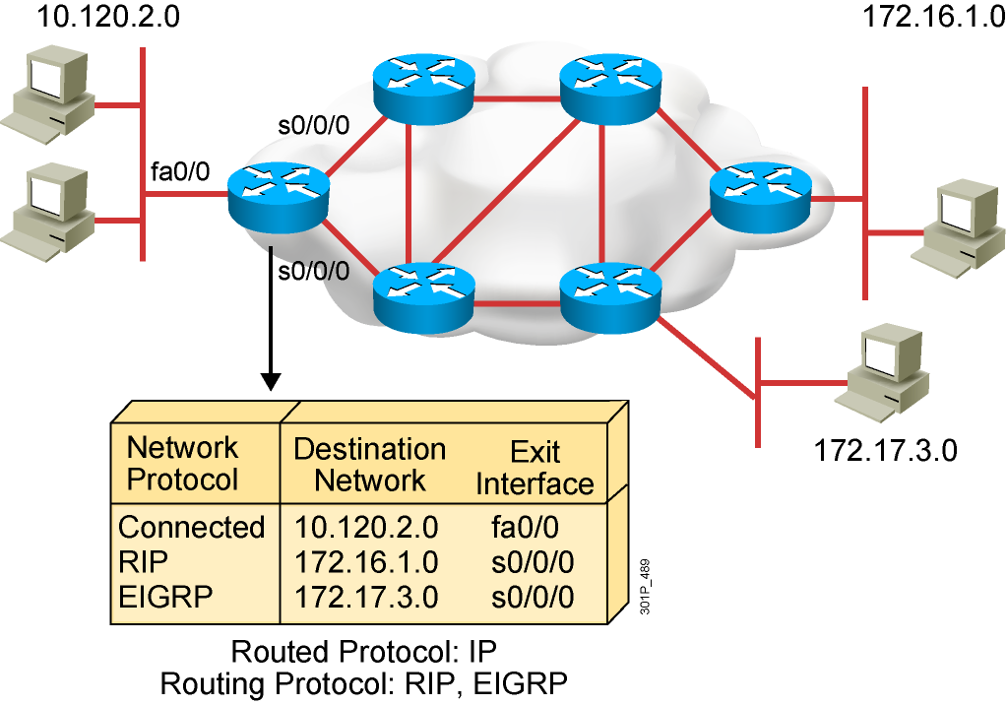
What Is a Routing Protocol?
Routing protocols are used between routers to determine paths and maintain routing tables.
After the path is determined, a router can route a routed protocol.
Notes:
Purpose: This figure introduces students to routing protocols and compares routing protocols to routed protocols.
Emphasize: If network 10.120.2.0 wants to know about network 172.16.2.0, it must learn it from its S0 (or possibly S1) interface.
Note: The two routing protocols that will be taught in this course are RIP and IGRP. They are both distance vector routing protocols.

Slide 4
Routing Protocol

Slide 5
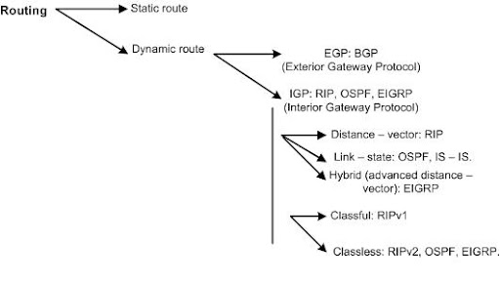
Overview routing

Slide 6
Static vs. Dynamic Routes
Static Route
Uses a route that a network administrator enters into the router manually
Example: ip route
Dynamic Route
Uses a route that a network routing protocol adjusts automatically for topology or traffic changes
Example: RIP, OSPF,…
Notes:
Purpose: This figure introduces students to static and dynamic routes.
Emphasize: Static knowledge is administered manually—a network administrator enters it into the router’s configuration. The administrator must manually update this static route entry whenever an internetwork topology change requires an update. Static knowledge can be private—by default it is not conveyed to other routers as part of an update process. You can, however, configure the router to share this knowledge.
Dynamic knowledge works differently. After the network administrator enters configuration commands to start dynamic routing, route knowledge is updated automatically by a routing process. Whenever new topology information is received from the internetwork, routers update neighbors about the route change.

Slide 7
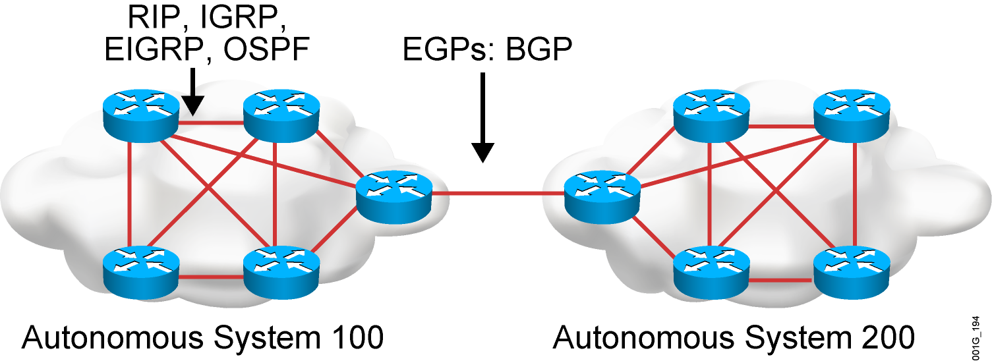
Autonomous Systems: Interior or Exterior Routing Protocols
An autonomous system is a collection of networks under a common administrative domain.
IGPs operate within an autonomous system.
EGPs connect different autonomous systems.
Notes:
Purpose: This figure discusses autonomous systems, IGPs and EGPs.
Emphasize: Introduce the interior/exterior distinctions for routing protocols, as follows:
Interior routing protocols are used within a single autonomous system
Exterior routing protocols are used to communicate between autonomous systems
The design criteria for an interior routing protocol require it to find the best path through the network. In other words, the metric and how that metric is used is the most important element in an interior routing protocol.
Exterior protocols are used to exchange routing information between networks that do not share a common administration. IP exterior gateway protocols require the following three sets of information before routing can begin:
A list of neighbor (or peer) routers or access servers with which to exchange routing information
A list of networks to advertise as directly reachable
The autonomous system number of the local router

Slide 8
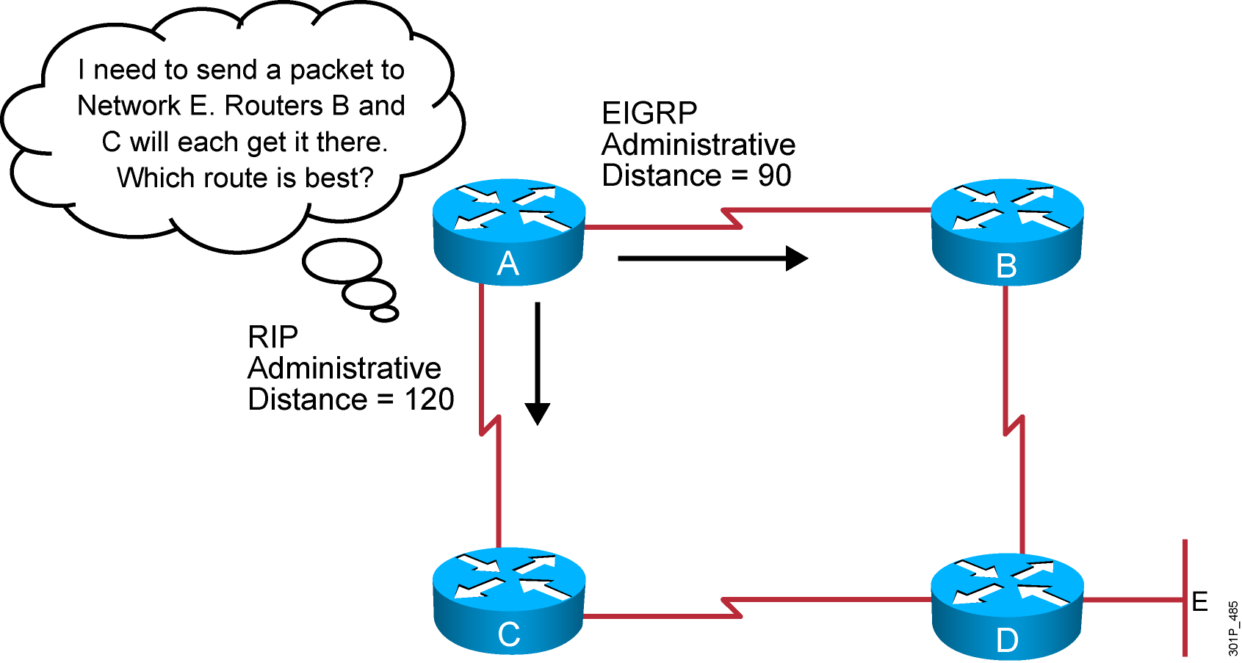
Administrative Distance: Ranking Routes
Routers choose the routing source with the best administrative distance:
RIP has an administrative distance of 120.
OSPF has an administrative distance of 110.
EIGRP has an administrative distance of 90.
Notes:
5
Purpose: This figure introduces administrative distance.
Emphasize: An administrative distance is a rating of the trustworthiness of a routing information source, such as an individual router or a group of routers. In a large network, some routing protocols and some routers can be more reliable than others as sources of routing information.
The default administrative distance for static routes and various routing protocols is listed in the Student Guide. The lower the distance, the more trustworthy the route is. For example, in the figure, the packet would learn the route learned via IGRP.

Slide 9
Classful Routing Protocol
Classful routing protocols do not include the subnet mask with the route advertisement.
Within the same network, consistency of the subnet masks is assumed.
Summary routes are exchanged between foreign networks.
These are examples of classful routing protocols:
RIPv1
IGRP (not now)

Slide 10
Classless Routing Protocol
Classless routing protocols include the subnet mask with the route advertisement.
Classless routing protocols support a variable-length subnet mask (VLSM).
Summary routes can be manually controlled within the network.
These are examples of classless routing protocols:
RIPv2
EIGRP
OSPF
IS-IS

Slide 11
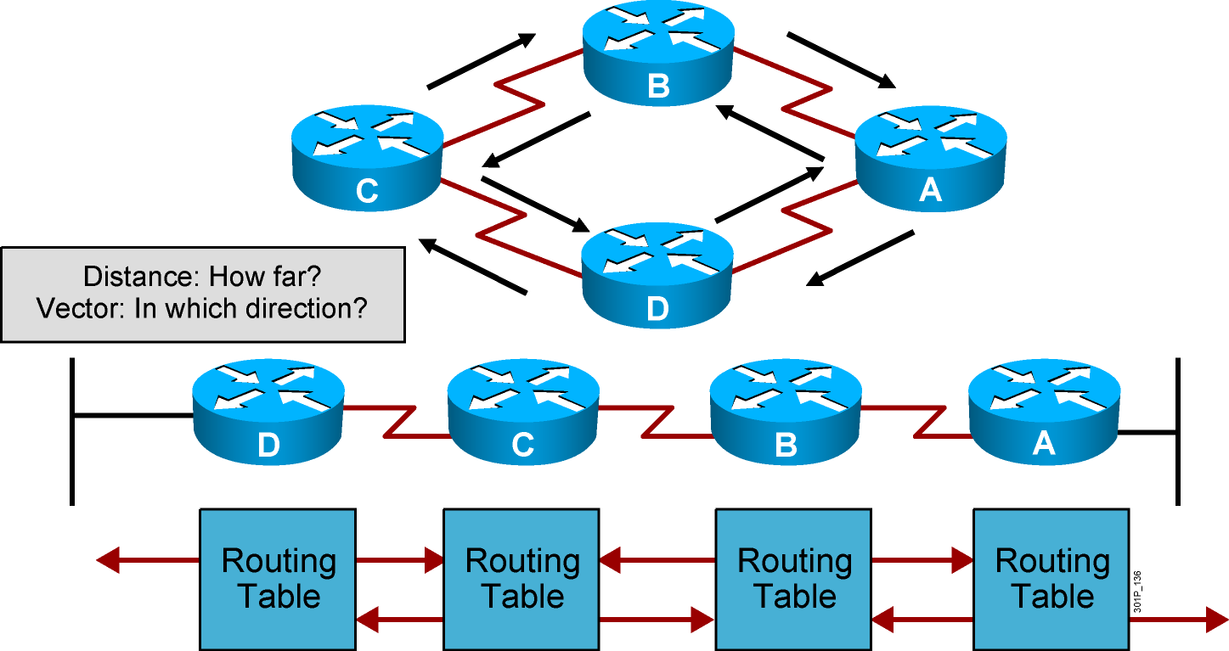
Distance Vector Routing Protocols
Routers pass periodic copies of their routing table to neighboring routers and accumulate distance vectors
Notes:
Purpose: This figure introduces the distance vector routing algorithm, the first of the classes of routing protocols, and outlines how it operates.
Emphasize: Distance vector algorithms do not allow a router to know the exact topology of an internetwork.
This information is somewhat analogous to the information found on signs at a highway intersection. A sign points toward a road leading away from the intersection and indicates the distance to the destination.
Further down the highway, another sign also points toward the destination, but now the distance to the destination is shorter.
As long as each successive point on the path shows that the distance to the destination is successively shorter, the traffic is following the best path.

Slide 12
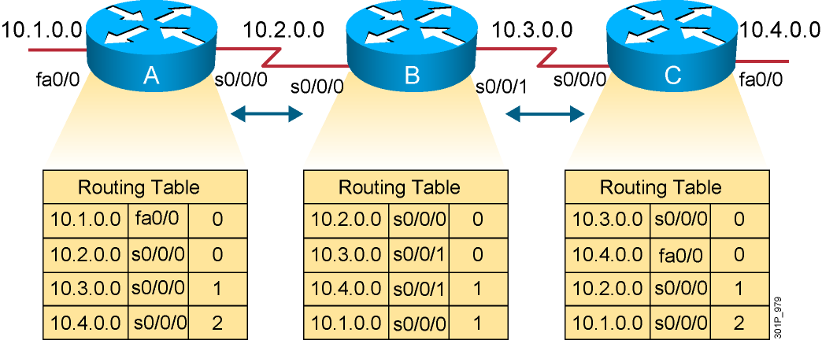
Sources of Information and Discovering Routes
Routers discover the best path to destinations from each neighbor.
Notes:
Layer 3 of 3
Emphasize: Layer 3 adds the final entries received some time later that have distances of 2 from routers A and C.

Slide 13
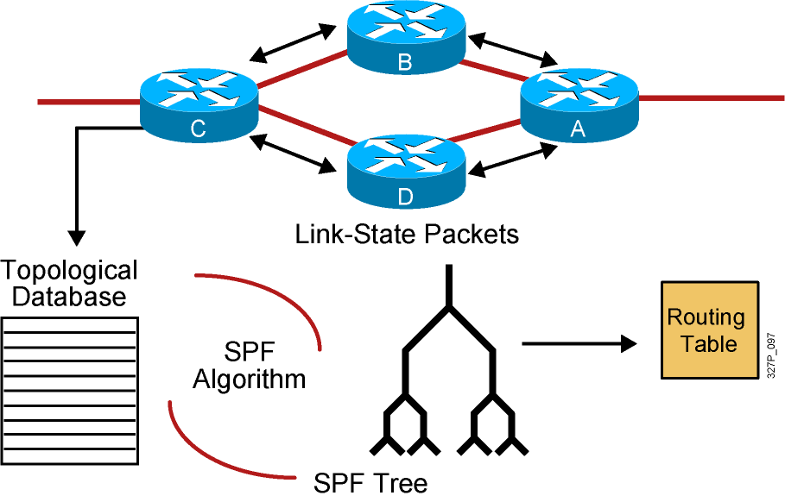
Link-State Routing Protocols
After an initial flood of LSAs, link-state routers pass small, event-triggered link-state updates to all other routers.
Notes:
Purpose: This figure introduces the link-state routing algorithm, the second of the classes of routing protocols, and outlines how it operates.
Emphasize: In contrast with the analogy about the distance vector information being like individual road signs that show distance, link-state information is somewhat analogous to a road map with a “you are here” pointer showing the map reader’s current location. This larger perspective indicates the shortest path to the destination. Each router has its own map of the complete topology.
Link-state routing is not covered further in this course. Refer students interested in more details to the ACRC course.

Slide 14
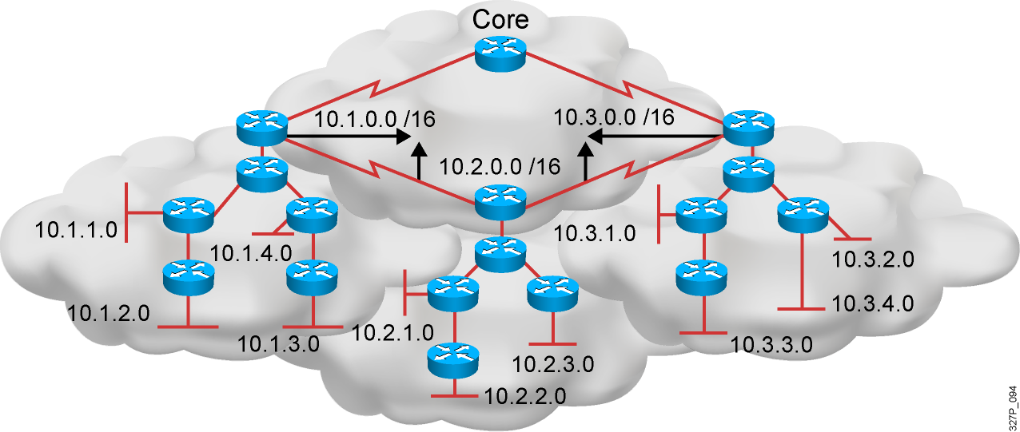
EIGRP
Hybrid
Advanced distance vector
Rapid convergence
100% loop-free classless routing
Easy configuration
Incremental updates
Load balancing across equal- and unequal-cost pathways
Flexible network design
Multicast and unicast instead of broadcast address
Support for VLSM and discontiguous subnets
Manual summarization at any point in the internetwork
Support for multiple network layer protocols

Slide 15
Benefits and Drawbacks of Link-State Routing
Benefits of link-state routing:
Fast convergence:
Changes are reported immediately by the affected source
Robustness against routing loops:
Routers know the topology
Link-state packets are sequenced and acknowledged
Hierarchical network design enables optimization of resources.
Drawbacks of link-state routing:
Significant demands for resources:
Memory (three tables: adjacency, topology, forwarding)
CPU (Dijkstra’s algorithm can be intensive, especially when there are many instabilities)
Requires very strict network design
Configuration can be complex when tuning various parameters and when design is complex

Slide 16
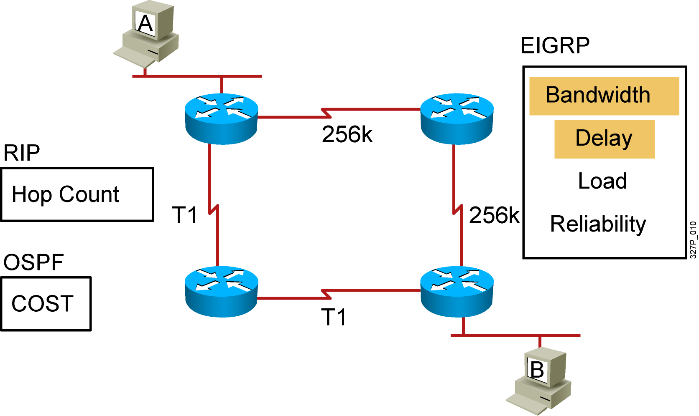
Selecting the Best Route Using Metrics
Notes:
Emphasize: How the routing algorithm defines “best” determines the most important characteristics of each routing algorithm.
Hop count—Some routing protocols use hop count as their metric. Hop count refers to the number of routers a packet must go through to reach a destination. The lower the hop count, the better the path. Path length is used to indicate the sum of the hops to a destination. As indicated in the figure, RIP uses hop count for its metric.
Ticks—Metric used with Novell IPX to reflect delay. Each tick is 1/18th of a second.
Cost—Factor used by some routing protocols to determine the best path to a destination; the lower the cost, the better the path. Path cost is the sum of the costs associated with each link to a destination.
Bandwidth—Although bandwidth is the rating of a link’s maximum throughput, routing through links with greater bandwidth does not always provide the best routes. For example, if a high-speed link is busy, sending a packet through a slower link might be faster. As indicated in the figure with highlighting, delay and bandwidth comprise the default metric for IGRP.
Delay—Depends on many factors, including the bandwidth of network links, the length of queues at each router in the path, network congestion on links, and the physical distance to be traveled. A conglomeration of variables that change with internetwork conditions, delay is a common and useful metric. As indicated in the figure with highlighting, delay and bandwidth comprise the default metric for IGRP.
Load—Dynamic factor can be based on a variety of measures, including CPU use and packets processed per second. Monitoring these parameters on a continual basis can itself be resource intensive.

Slide 17
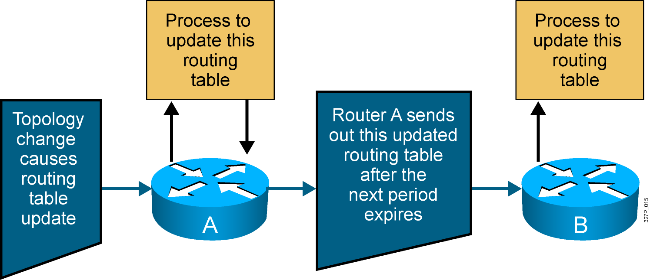
Maintaining Routing Information
Updates proceed step by step from router to router.
Notes:
Layer 3 of 3
Layer 3 adds router B, which receives the updated routing table from router A. In turn, router B will perform its own process to update its routing table given this new topology update from router A.
Distance vector updates occur step by step.
Typically, a router sends updates by multicasting its table on each configured port, but other methods, such as sending the table only to preconfigured neighbors, are employed by some routing algorithms.
Multicast is used by the RIP2, OSPF, and EIGRP routing protocols. RIP and IGRP use broadcast.
The routing table can be sent routinely and periodically, or whenever a change in the topology is discovered. Updates sent when changes occur are called triggered updates.

Slide 18
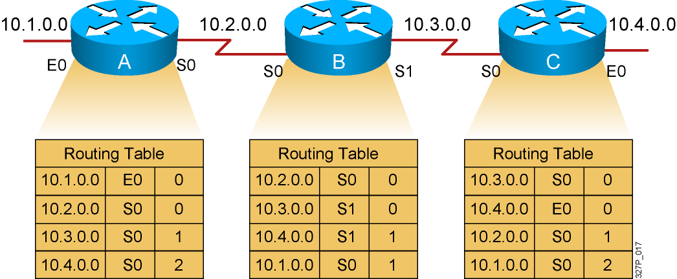
Inconsistent Routing Entries: Counting to Infinity and Routing Loops
Each node maintains the distance from itself to each possible destination network.
Notes:
Slide 1 of 4
Purpose: This figure describes the first of the general problems that a distance vector protocol could face without the corrective influence of some countermeasure.
Emphasize: Layer 1 shows the original state of the network and routing tables. All routers have consistent knowledge and correct routing tables. In this example, the cost function is hop count, so the cost of each link is 1. Router C is directly connected to network 10.4.0.0 with a distance of 0. Router A’s path to network 10.4.0.0 is through router B, with a hop count of 2.

Slide 19
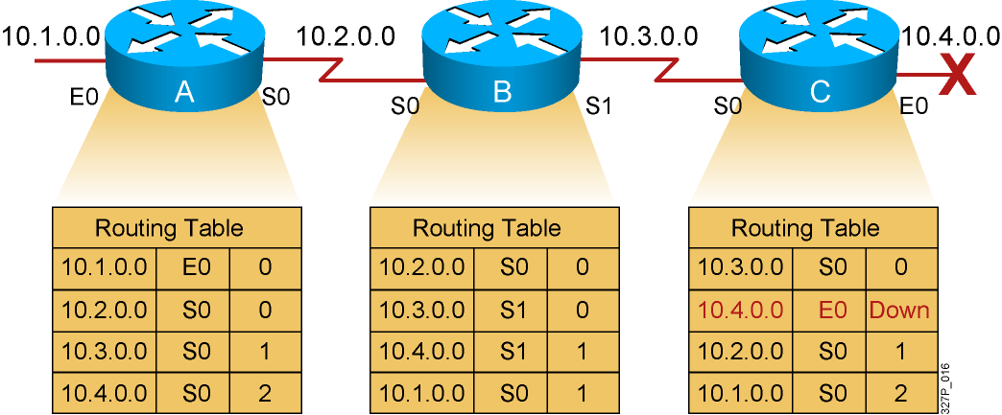
Counting to Infinity
Slow convergence produces inconsistent routing.
Notes:
Slide 2 of 4
Emphasize: In Layer 2, router C has detected the failure of network 10.4.0.0 and stops routing packets out its E0 interface. However, router A has not yet received notification of the failure and still believes it can access network 10.4.0.0 through router B. Router A’s routing table still reflects a path to network 10.4.0.0 with a distance of 2.

Slide 20
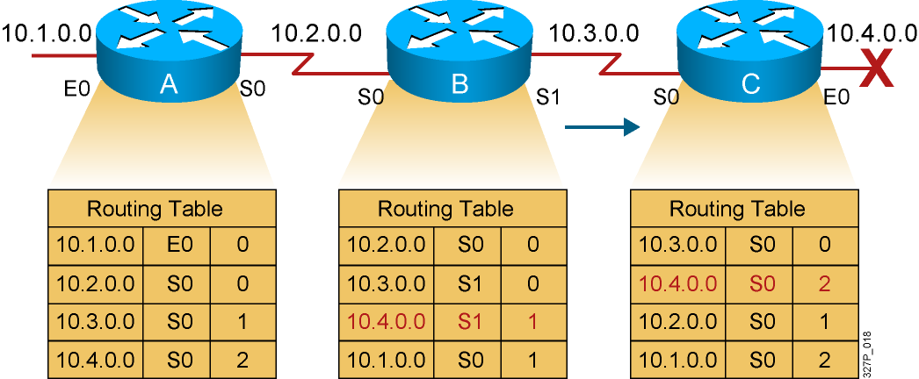
Counting to Infinity (Cont.)
Router C concludes that the best path to network 10.4.0.0 is through router B.
Notes:
Slide 3 of 4
Emphasize: Because router B’s routing table indicates a path to network 10.4.0.0, router C believes it now has a viable path to 10.4.0.0 through router B. Router C updates its routing table to reflect a path to network 10.4.0.0 with a hop count of 2.

Slide 21
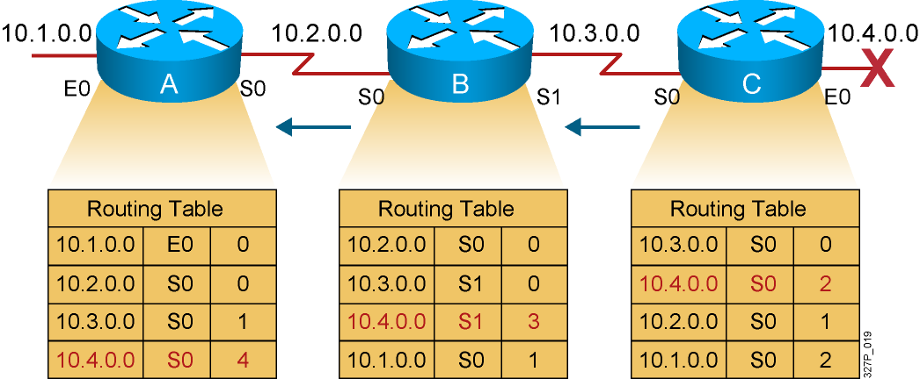
Counting to Infinity (Cont.)
Router A updates its table to reflect the new but erroneous hop count.
Notes:
Slide 4 of 4
Emphasize: In Layer 4, router A receives the new routing table from router B, detects the modified distance vector to network 10.4.0.0, and recalculates its own distance vector to network 10.4.0.0 as 3.
If all routers in an internetwork do not have up-to-date, accurate information about the state of the internetwork, they might use incorrect routing information to make a routing decision.
The use of incorrect information might cause packets to take less-than-optimum paths or paths that return packets to routers that they have already visited.

Slide 22
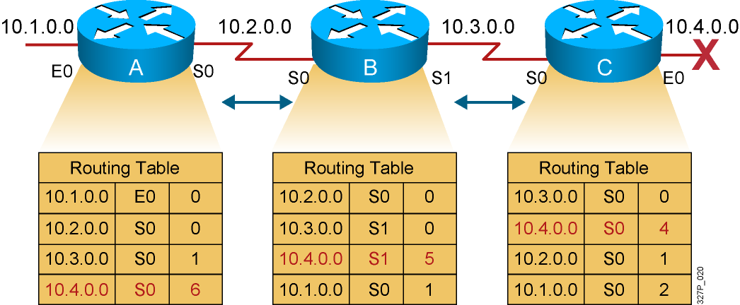
Counting to Infinity (Cont.)
The hop count for network 10.4.0.0 counts to infinity.
Notes:
Purpose: This figure describes another of the general problems that a distance vector protocol could face without the corrective influence of some countermeasure.
Emphasize: Both routers conclude that the best path to network 10.4.0.0 is through each other and continue to bounce packets destined for network 10.4.0.0 between each other, incrementing the distance vector by 1 each time.
This condition, called count to infinity, continuously loops packets around the network, despite the fundamental fact that the destination network 10.4.0.0 is down. While the routers are counting to infinity, the invalid information allows a routing loop to exist.
A related concept is the Time-to-Live (TTL) parameter. The TTL is a packet parameter that decreases each time a router processes the packet. When the TTL reaches zero, a router discards or drops the packet without forwarding it. A packet caught in a routing loop is removed from the internetwork when its TTL expires.

Slide 23
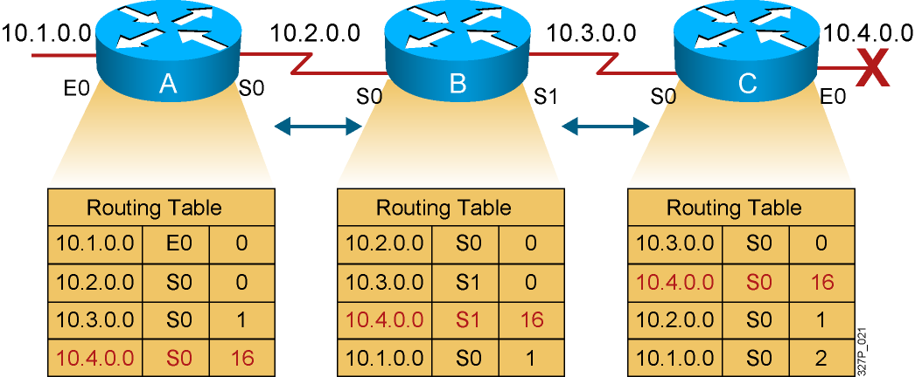
Solution to Counting to Infinity: Defining a Maximum
A limit is set on the number of hops to prevent infinite loops.
Notes:
Purpose: This figure describes a corrective measure that attempts to solve the routing loop problems that a distance vector protocol could face.
Emphasize: Routing loops occur only when routing knowledge being propagated has not yet reached the entire internetwork—when the internetwork has not converged after a change. Fast convergence minimizes the chance for a routing loop to occur, but even the smallest interval leaves the possibility open.
To avoid prolonging the count-to-infinity time span, distance vector protocols define infinity as some maximum number. This number refers to a routing metric, such as a hop count.
With this approach, the routing protocol permits the routing loop until the metric exceeds its maximum allowed value. This example shows this defined maximum as 16 hops. Once the metric value exceeds the maximum, network 10.4.0.0 is considered unreachable.

Slide 24
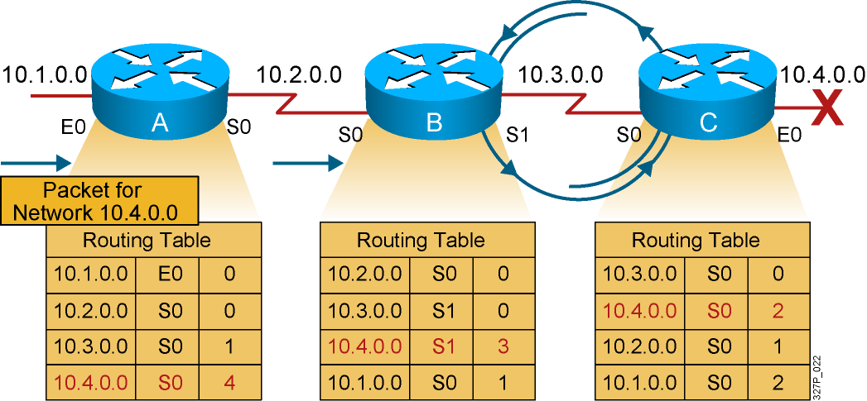
Routing Loops
Packets for network 10.4.0.0 bounce (loop) between routers B and C.
Notes:
Slide 4 of 4
Emphasize: In Layer 4, router A receives the new routing table from router B, detects the modified distance vector to network 10.4.0.0, and recalculates its own distance vector to network 10.4.0.0 as 3.
If all routers in an internetwork do not have up-to-date, accurate information about the state of the internetwork, they might use incorrect routing information to make a routing decision.
The use of incorrect information might cause packets to take less-than-optimum paths or paths that return packets to routers that they have already visited.

Slide 25
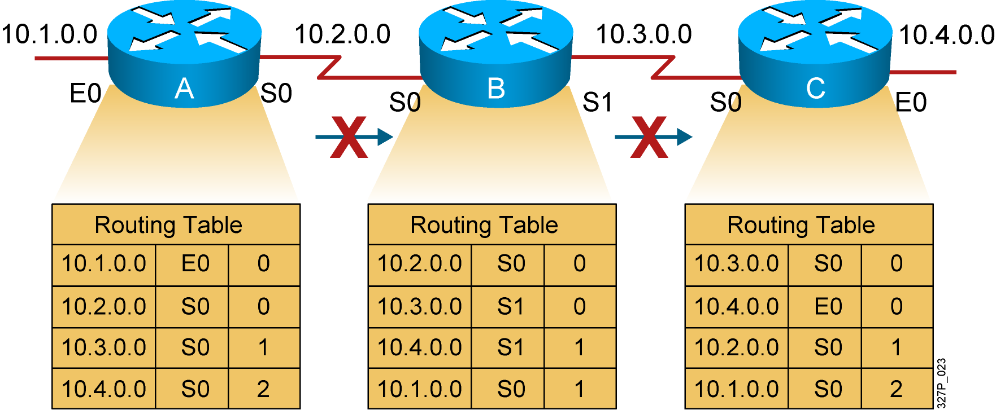
Solution to Routing Loops: Split Horizon
It is never useful to send information about a route back in the direction from which the original information came.
Notes:
Purpose: This figure introduces the corrective measure known as “split horizon.” The split horizon technique attempts to solve routing loops.
Emphasize: The split horizon technique attempts to eliminate routing loops and speed up convergence. The rule of split horizon is that it is never useful to send information about a route back in the direction from which the original packet came. In the example:
Router C originally announced a route to network 10.4.0.0 to router B. It makes no sense for router B to announce to router C that router B has access to network 10.4.0.0 through router C.
Given that router B passed the announcement of its route to network 10.4.0.0 to router A, it makes no sense for router A to announce its distance from network 10.4.0.0 to router B.
Because router B has no alternative path to network 10.4.0.0, router B concludes that network 10.4.0.0 is inaccessible.
In its basic form, the split-horizon technique simply omits from the message any information about destinations routed on the link. This strategy relies either on routes never being announced or on old announcements fading away through a timeout mechanism.
Split horizon also improves performance by eliminating unnecessary routing updates. Under normal circumstances, sending routing information back to the source of the information is unnecessary.

Slide 26
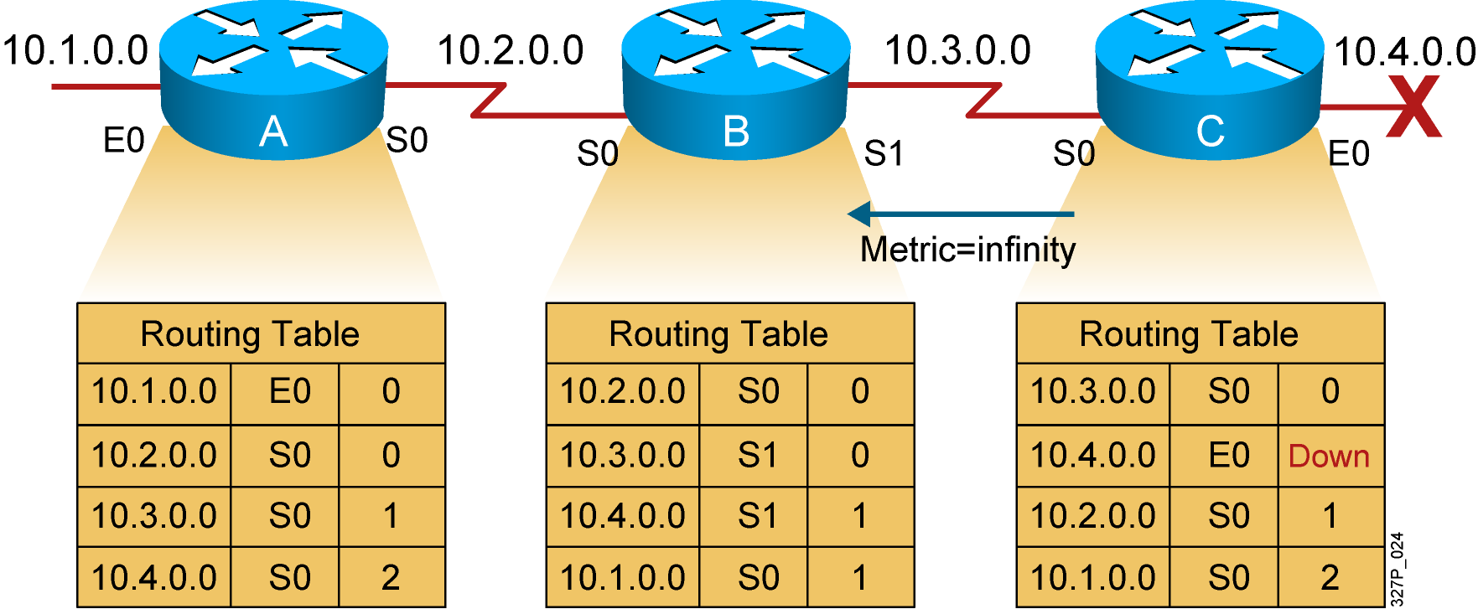
Solution to Routing Loops: Route Poisoning and Poison Reverse
Routers advertise the distance of routes that have gone down to infinity.
Notes:
1, 95, 133

Slide 27
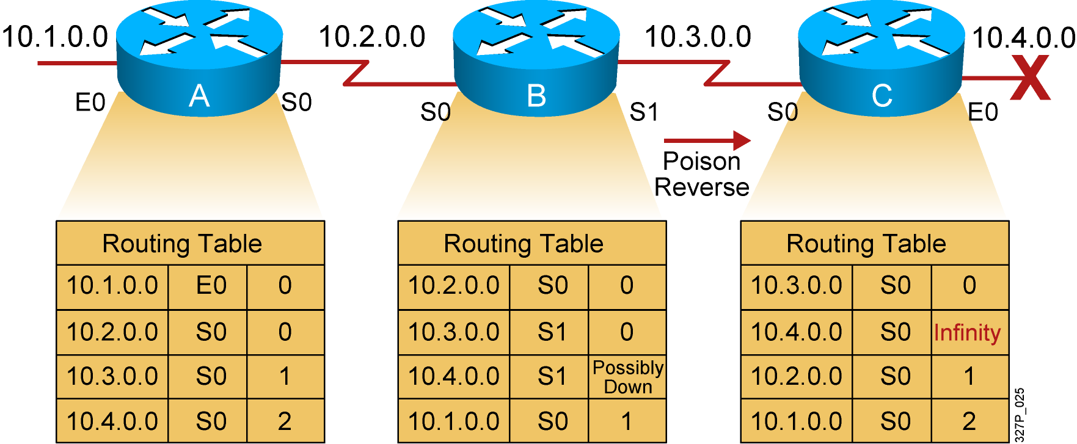
Solution to Routing Loops: Route Poisoning and Poison Reverse (Cont.)
Poison reverse overrides split horizon.
Notes:
Purpose: This figure explains poison reverse.
Emphasize: Poison reverse overrides the split-horizon solution.

Slide 28
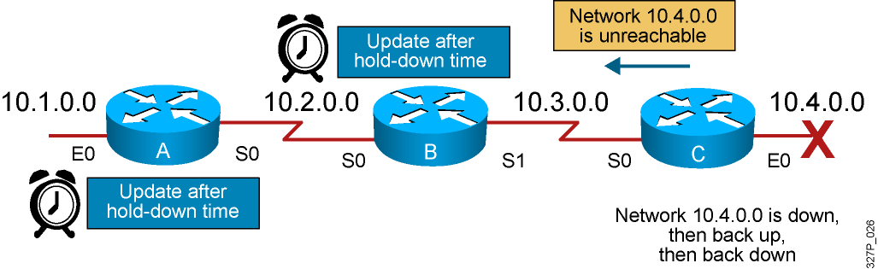
Solution to Routing Loops: Hold-Down Timers
The router keeps an entry for the “possibly down” state in the network, allowing time for other routers to recompute for this topology change.
Notes:
Purpose: This figure describes how hold-down timers avoid the general problems that a routing protocol could face.
Emphasize: Hold-down timers are used to prevent regular update messages from inappropriately reinstating a route that may have gone bad.
Hold-downs tell routers to hold any changes that might affect routes for some period of time.
The hold-down period is usually calculated to be just greater than the period of time necessary to update the entire network with a routing change.
Note: A network administrator can configure the hold-down timers on several routers to work together in tandem.

Slide 29
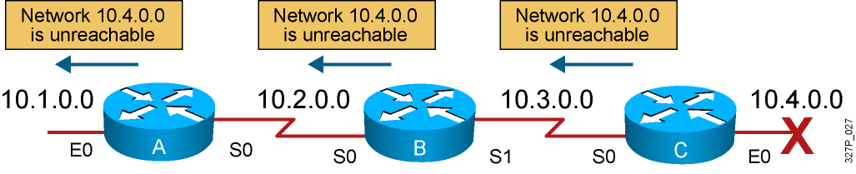
Triggered Updates
The router sends updates when a change in its routing table occurs.
Notes:
Purpose: This figure describes how triggered updates avoid the general problems that a routing protocol could face.
Emphasize: Normally, new routing tables are sent to neighboring routers on a regular basis. A triggered update is a new routing table that is sent immediately, in response to some change.
Each update triggers a routing table change in the adjacent routers, which, in turn, generate triggered updates notifying their adjacent neighbors of the change. This wave propagates throughout that portion of the network where routes went through the link.
Triggered updates would be sufficient if we could guarantee that the wave of updates reached every appropriate router immediately. However, there are two problems:
Packets containing the update message can be dropped or corrupted by some link in the network.
The triggered updates do not happen instantaneously. It is possible that a router that has not yet received the triggered update will issue a regular update at just the wrong time, causing the bad route to be reinserted in a neighbor that had already received the triggered update.
Coupling triggered updates with holddowns is designed to get around these problems. Because the hold-down rule says that when a route is removed, no new route will be accepted for the same destination for some period of time, the triggered update has time to propagate throughout the network.

Slide 30
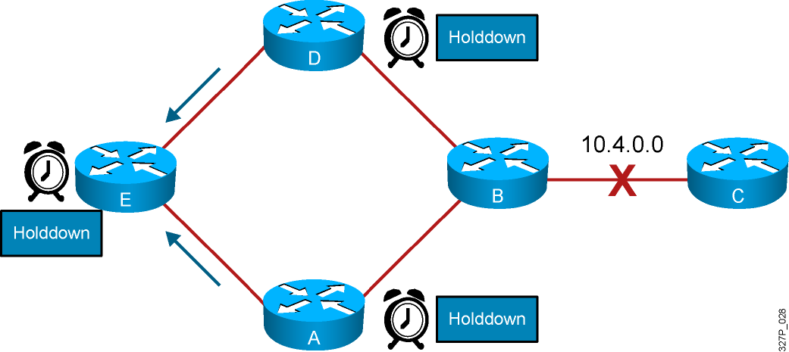
Eliminating Routing Loops
Notes:
Slide 2 of 6
Purpose: This figure continues to describe how the solution works to prevent routing loops in a more complex network design.
Emphasize: Describe that routers D and A both set their hold-down timers and send triggered updates to router E about the status of network 10.4.0.0. Router E also sets its hold-down timer.

Slide 31
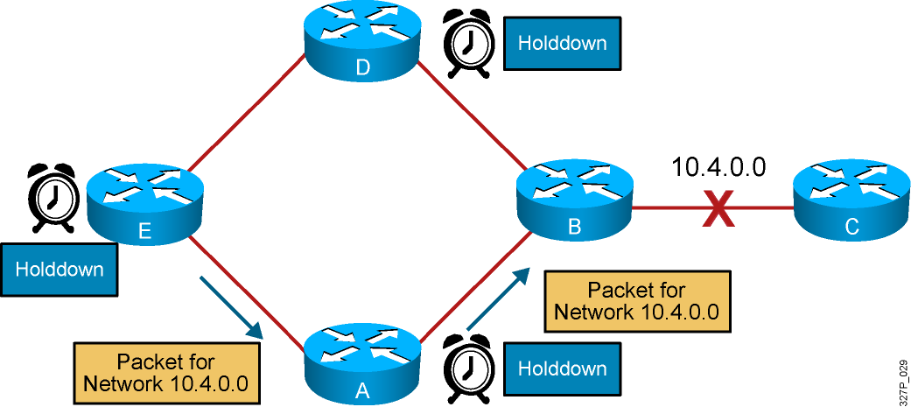
Eliminating Routing Loops (Cont.)
Notes:
Slide 4 of 6
Purpose: This figure continues to describe how the solution works to prevent routing loops in a more complex network design.
Emphasize: While in hold-down state, routers A, D, and E will still attempt to forward packets to network 10.4.0.0.

Slide 32
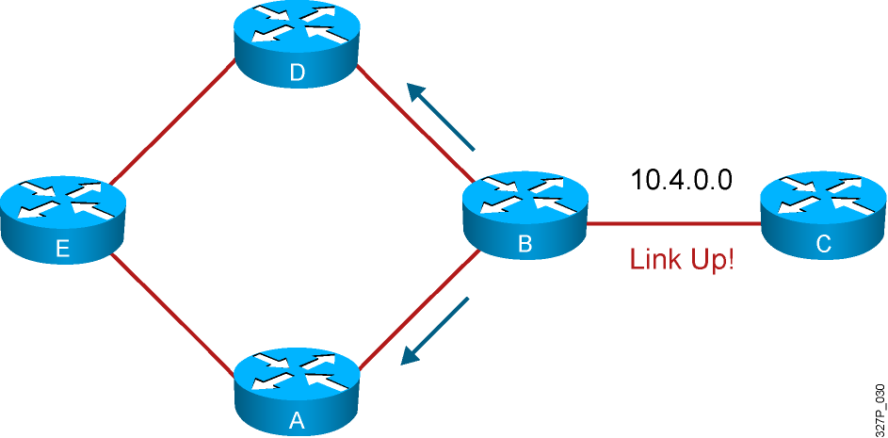
Eliminating Routing Loops (Cont.)
Notes:
Slide 5 of 6
Purpose: This figure continues to describe how the solution works to prevent routing loops in a more complex network design.
Emphasize: When the link is back up, router B will send a triggered update to router A and router D, notifying them that network 10.4.0.0 is active.

Slide 33
Benefits and Drawbacks of Link-State Routing
Benefits of link-state routing:
Fast convergence:
Changes are reported immediately by the affected source
Robustness against routing loops:
Routers know the topology
Link-state packets are sequenced and acknowledged
Hierarchical network design enables optimization of resources.
Drawbacks of link-state routing:
Significant demands for resources:
Memory (three tables: adjacency, topology, forwarding)
CPU (Dijkstra’s algorithm can be intensive, especially when there are many instabilities)
Requires very strict network design
Configuration can be complex when tuning various parameters and when design is complex

Slide 34
Summary
Dynamic routing requires administrators to configure either a distance vector or link-state routing protocol.
Distance vector routing protocols incorporate solutions such as split horizon, route poisoning, and hold-down timers to prevent routing loops.
Link-state routing protocols scale to large network infrastructures better than distance vector routing protocols, but they require more planning to implement.

